Slide 1
Notes:
Similar to result of stored procedure

Slide 2
Notes:
Subset of the data being retrieved and provide additional option

Slide 3
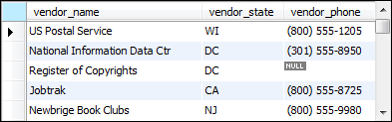
Notes:
You can pass this as a variable now
Notice the select statement is inside the view

Slide 4
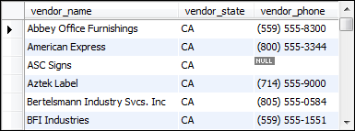
Notes:
Vendors_min is only available because we have a view
= temporary view (in the same sql script as where the view was instantiated)

Slide 5
Notes:
Once I create it, I can update it with other information
View is a subset (temporary table that can drop after usage)

Slide 8
Notes:
If it’s there, drop and create
If not, create

Slide 14
Notes:
Balance due cannot be upated since it’s done by 3 tower’ subtractions (operational process)
Cannot update just because

Slide 16
Notes:
SQL code runs through validation proce w/o any areaco

Slide 19
Notes:
If updating, will not update back in the original vendor_payment but the s

Slide 20


Slide 21
Notes:
Tyrying

Slide 22
Notes:
May impact source because it’s delete

